Slide 1

OBJECT-ORIENTED DESIGN PROJECT
SCFMS
Sasi Sai Nadh Boddu
Smart Campus Facility
Management System
GWID: G22742105
Group 24
Intelligent Solutions for Modern Campus Operations

Slide 2
AGENDA
Project Overview
01
Introduction & Objectives
02
Requirements Model — Use Case Diagram
03
Analysis Model — Domain Model
04
Activity Diagrams (6 Use Cases)
05
Design Model — Sequence Diagrams
06
Design Model — Class Diagram (BCE)
07
UI Design — Mock-up Prototype
08
Operational Prototype & Live Demo
SCFMS | Group 24
2 / 20

Slide 3

INTRODUCTION
Project Introduction
This project is Smart Campus Facility Management System. It is designed to help students easily find available rooms, book them, check in/check out, and report maintenance issues through one simple application. It also lets users track their bookings and ticket status, making campus facility usage more organized and efficient. In this prototype, all data is managed inside the application itself for demonstration purposes.
Implementation: Python (OO design, originally spec'd for Java)
6
8
15+
BCE
Use Cases
Campus Rooms
OO Classes
Architecture
SCFMS | Group 24
3 / 20

Slide 4
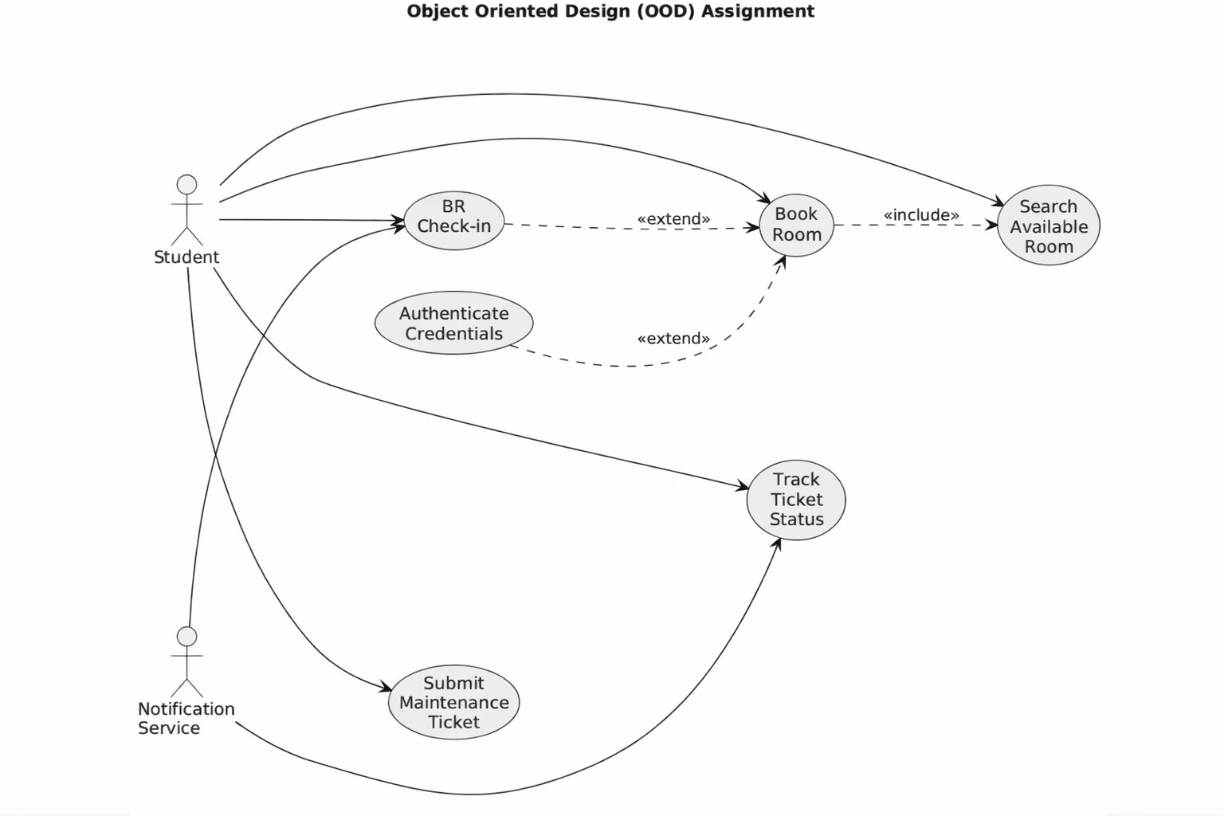
REQUIREMENTS MODEL
Use Case Model
Actors: Student, Notification Service
SCFMS | Group 24
4 / 20

Slide 5
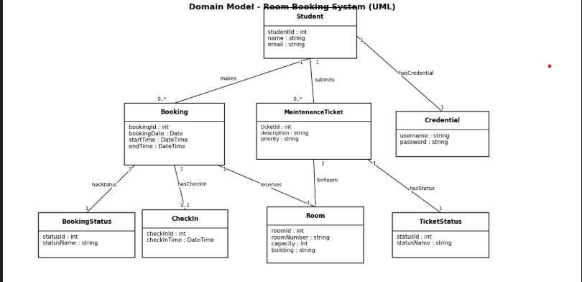
ANALYSIS MODEL
Domain Model
SCFMS | Group 24
5 / 20

Slide 6
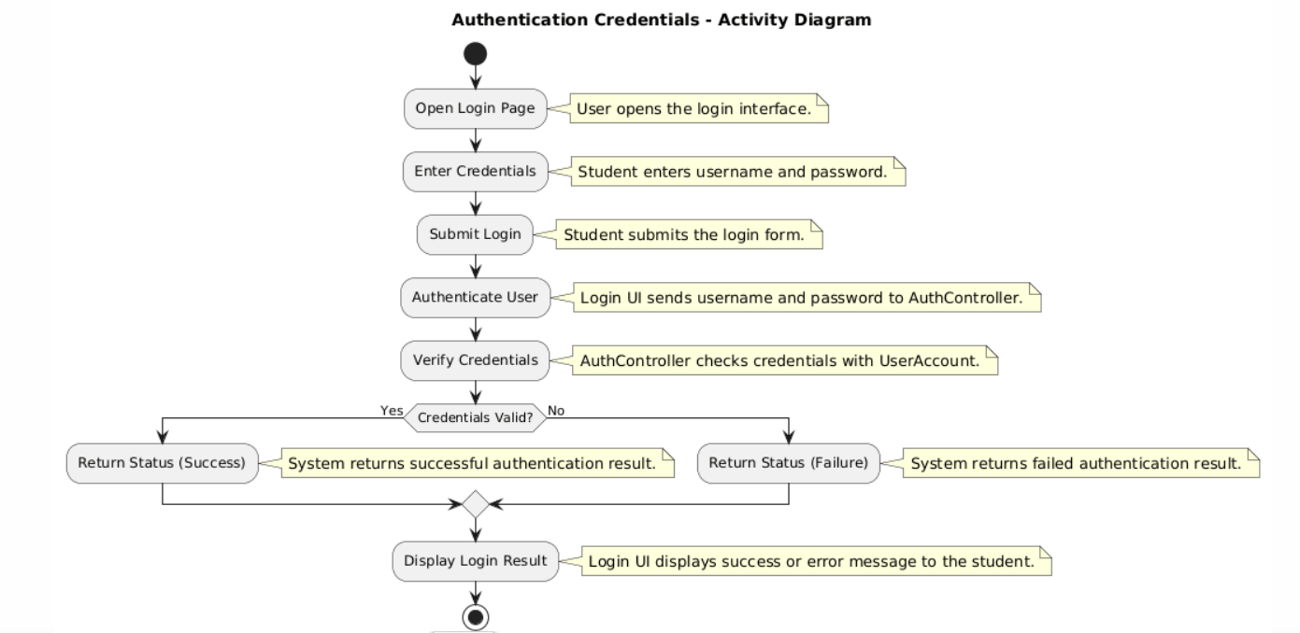
ANALYSIS MODEL
Activity Diagram — Authentication
SCFMS | Group 24
6 / 20

Slide 7
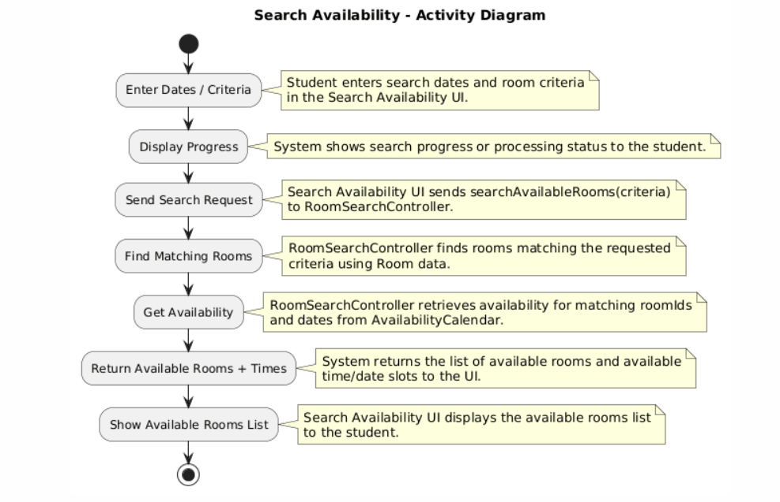
ANALYSIS MODEL
Activity Diagram — Search Availability
SCFMS | Group 24
7 / 20

Slide 8
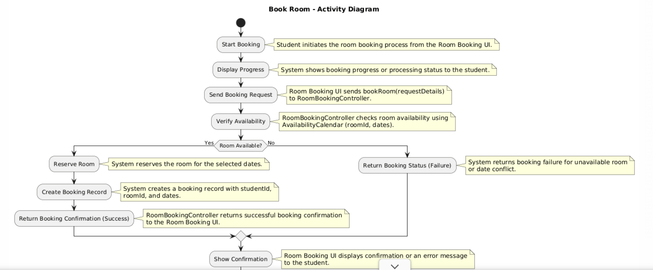
ANALYSIS MODEL
Activity Diagram — Book Room
SCFMS | Group 24
8 / 20

Slide 9
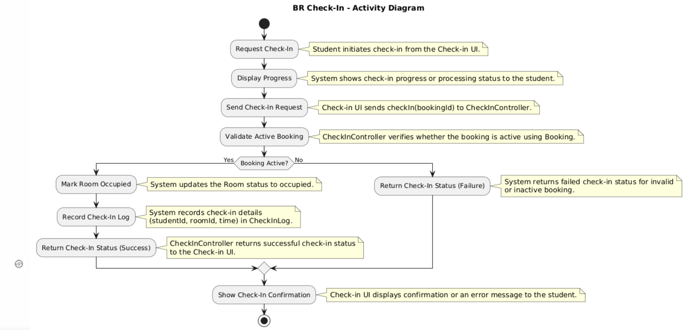
ANALYSIS MODEL
Activity Diagram — BR Check-In
SCFMS | Group 24
9 / 20

Slide 10
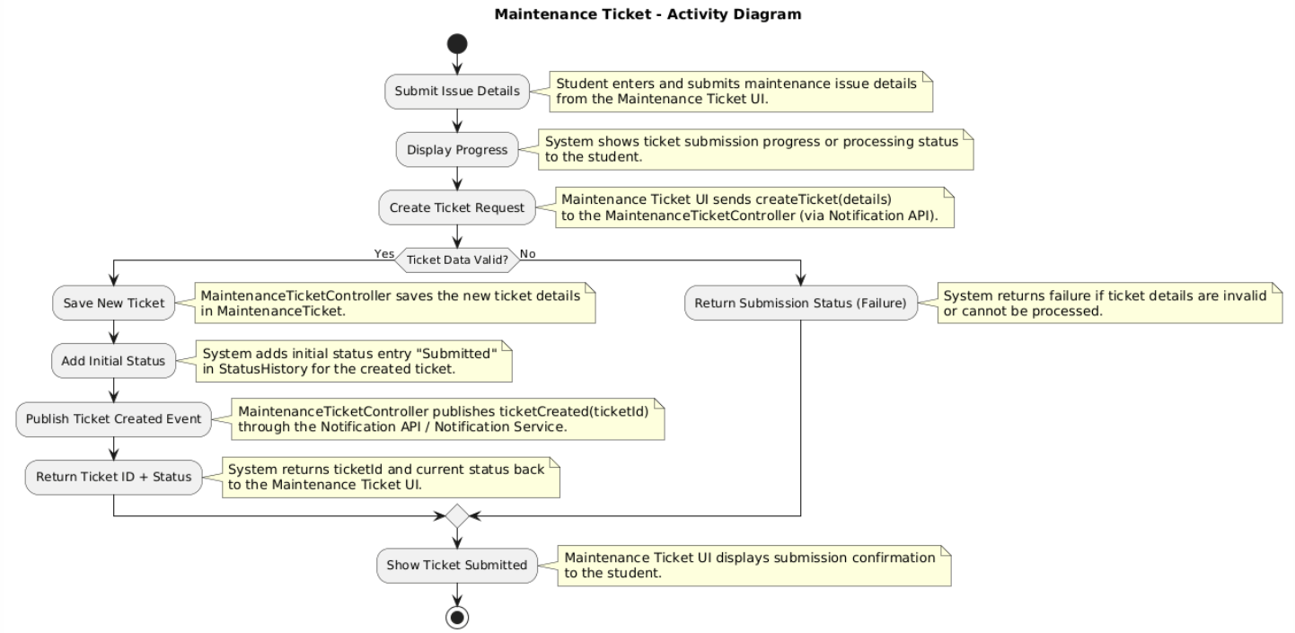
ANALYSIS MODEL
Activity Diagram — Maintenance Ticket
SCFMS | Group 24
10 / 20

Slide 11
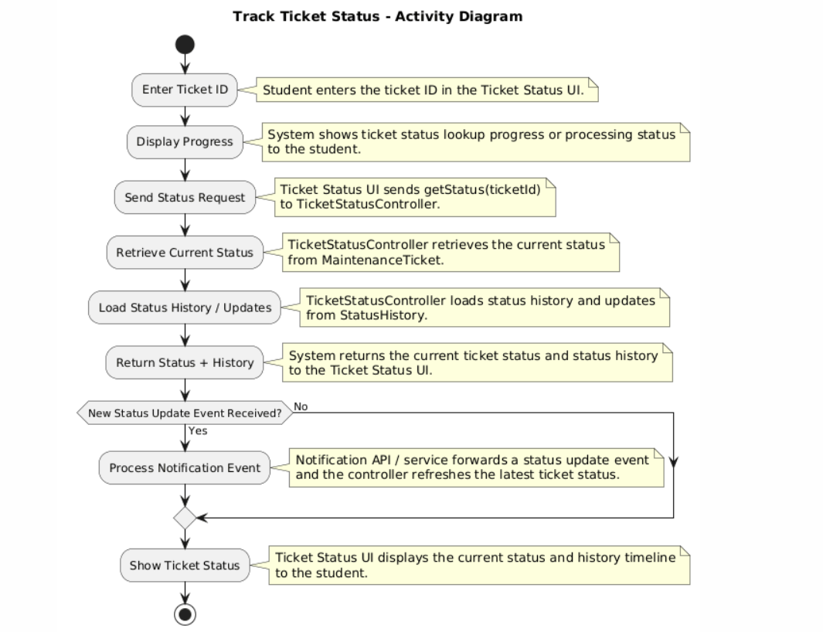
ANALYSIS MODEL
Activity Diagram — Track Ticket Status
SCFMS | Group 24
11 / 20

Slide 12
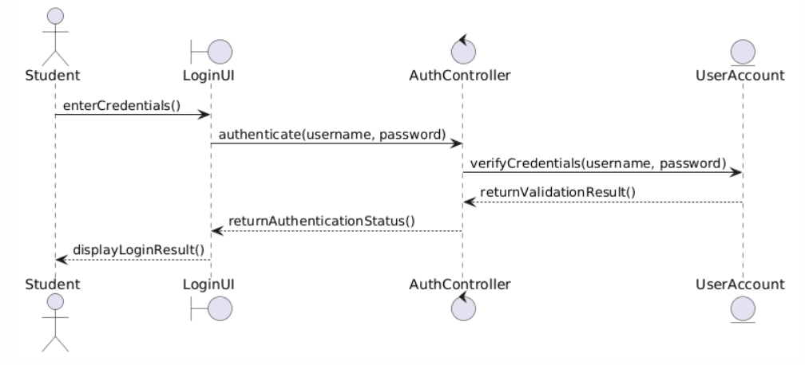
DESIGN MODEL
Sequence Diagram — Authentication
SCFMS | Group 24
12 / 20

Slide 13
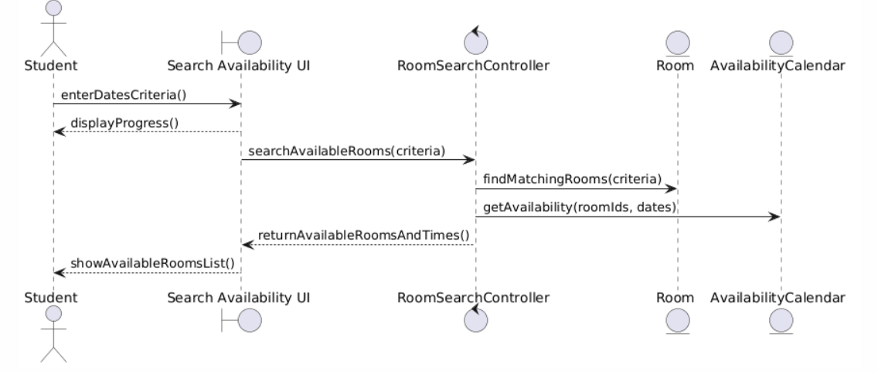
DESIGN MODEL
Sequence Diagram — Search Availability
SCFMS | Group 24
13 / 20

Slide 14
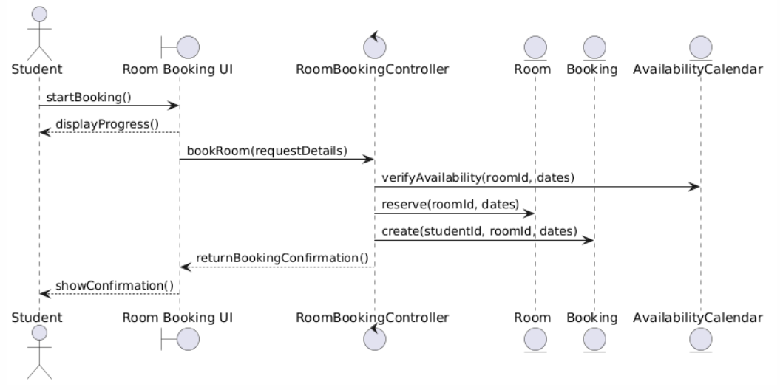
DESIGN MODEL
Sequence Diagram — Book Room
SCFMS | Group 24
14 / 20

Slide 15
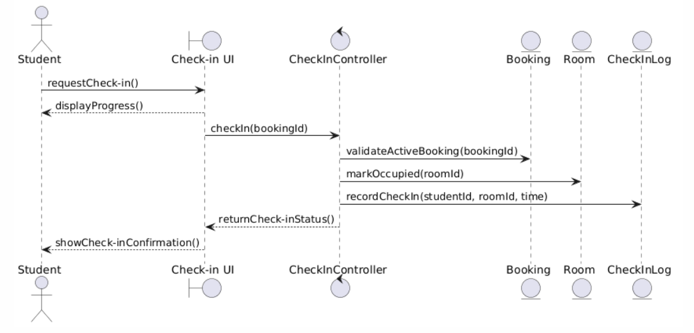
DESIGN MODEL
Sequence Diagram — BR Check-In
SCFMS | Group 24
15 / 20

Slide 16
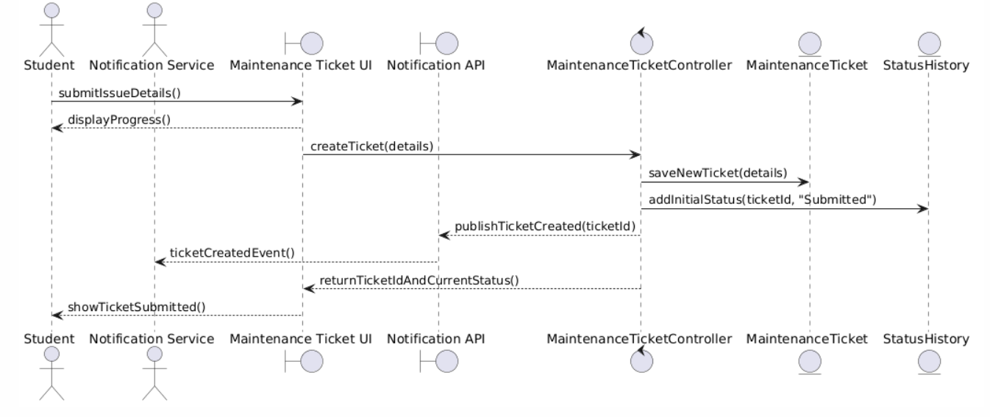
DESIGN MODEL
Sequence Diagram — Maintenance Ticket
SCFMS | Group 24
16 / 20

Slide 17
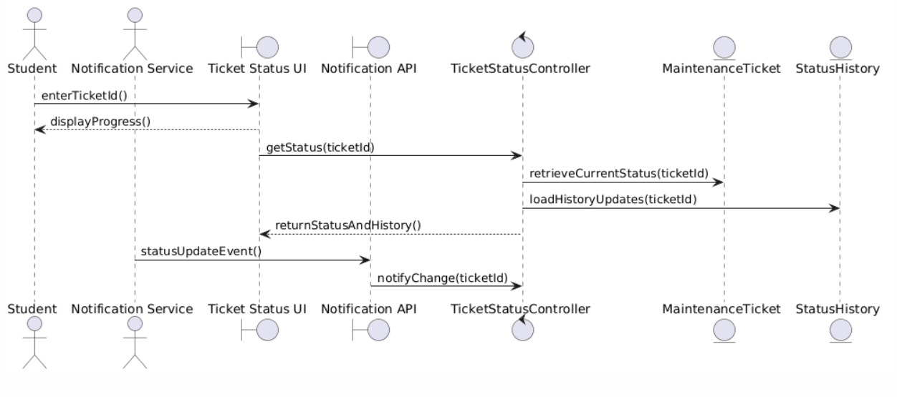
DESIGN MODEL
Sequence Diagram — Track Ticket Status
SCFMS | Group 24
17 / 20

Slide 18
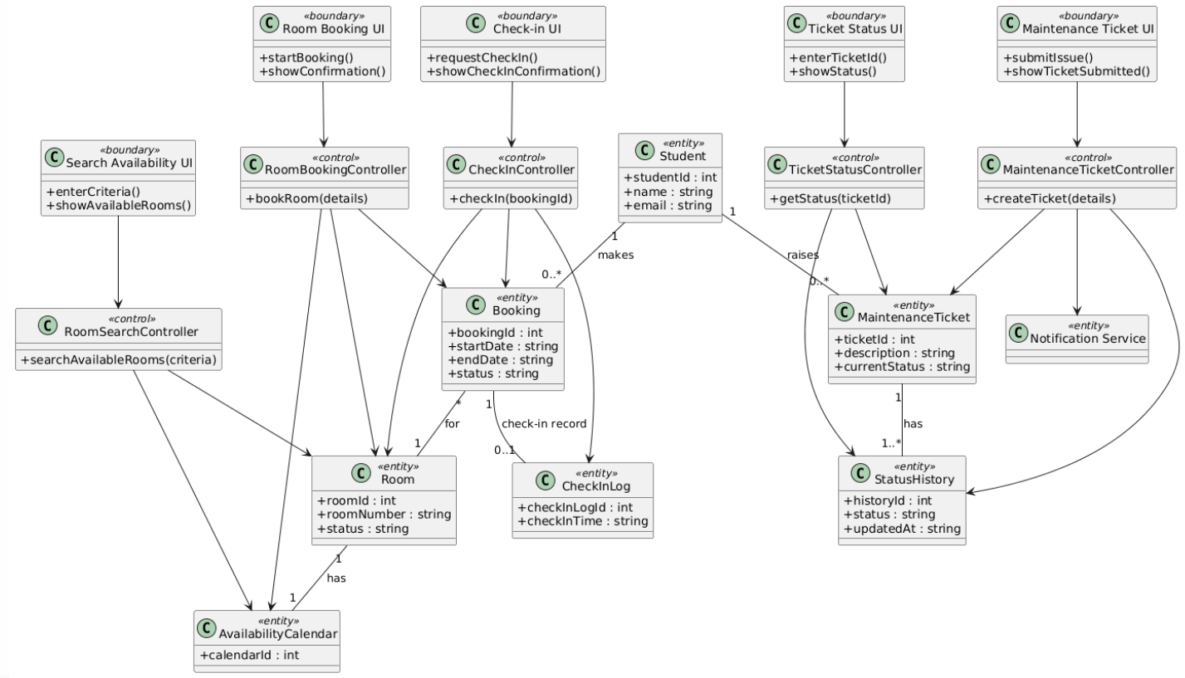
DESIGN MODEL
Class Diagram — BCE Pattern
SCFMS | Group 24
18 / 20

Slide 19
UI DESIGN
User Interface — Web Prototype
The operational prototype is a fully interactive single-page web application built with React, implementing all 6 use cases from the UML model.
🔐
Login & Auth
🔍
Room Search
📅
Room Booking
SHA-256 hashed credential verification with session management
Filter by date, time, and capacity with real-time availability
3-step guided flow with conflict prevention and confirmation
✅
Check-In
🛠️
Maintenance
📡
Ticket Tracking
One-click check-in updates room status to Occupied
Submit tickets with room selection and issue description
Status timeline with history: Open > In Progress > Resolved
Tech Stack: Python | OO Design (BCE) | React Web UI | SHA-256 Auth | In-Memory State
SCFMS | Group 24
19 / 20

Slide 20
Working Application
The Smart Campus Facility Management System is a Python-based working application that helps students manage campus room bookings and maintenance requests through a simple console interface. Users can log in with their credentials, search available rooms by date, time, and capacity, and confirm bookings instantly. The system also supports booking cancellation, room check-in, and simulated notifications for important actions. In addition, students can submit maintenance tickets for rooms or facilities and track their status updates over time. The application follows an object-oriented design using Boundary, Control, and Entity classes, making the system modular, organized, and easy to extend.
SCFMS | Group 24

Slide 21
Architectural Diagram
The Smart Campus Facility Management System follows a layered object-oriented architecture for handling room booking and maintenance workflows.
The application is developed in Python and is structured using the Boundary–Control–Entity design pattern. The Boundary layer manages user interaction, the Control layer handles business logic, and the Entity layer stores core system data such as students, rooms, bookings, tickets, and notifications.
The system provides a console-based interface where users can log in, search room availability, book rooms, cancel reservations, check in, and submit maintenance tickets through menu-driven operations.
The Control layer coordinates all major processes, including authentication, room search, booking validation, slot reservation, ticket creation, status updates, and notification generation. This ensures clear separation between input handling and application logic.
The Entity layer represents the main system objects such as Student, Room, Booking, MaintenanceTicket, and Notification. These entities maintain the data required for managing campus facilities and support state transitions like Pending, Confirmed, Checked-In, Cancelled, and Completed.
The application is designed as a modular standalone system, making it easy to test, extend, and upgrade into a GUI or web-based campus management platform in the future.

Slide 22
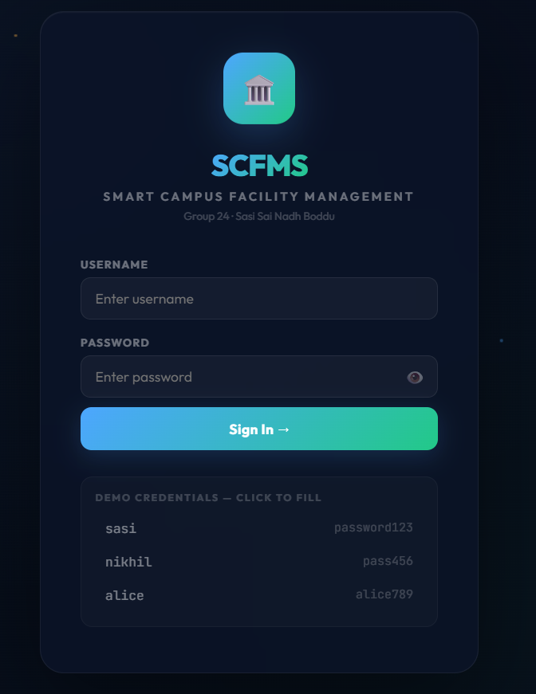
Facility Management Portal

Slide 23
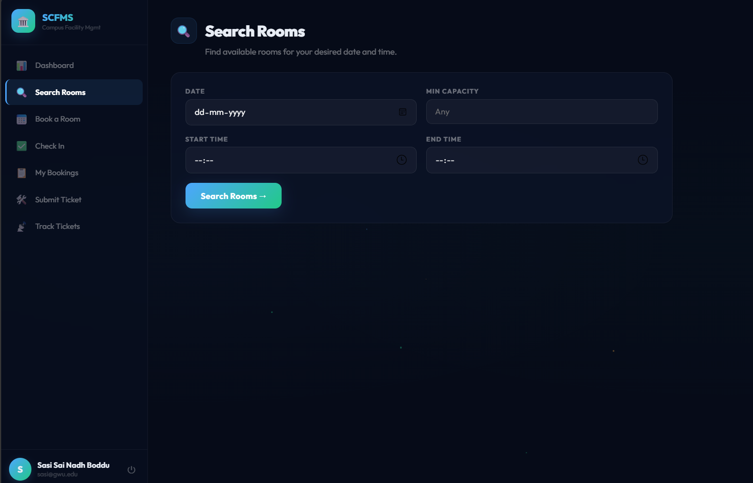
Search Available Rooms

Slide 24
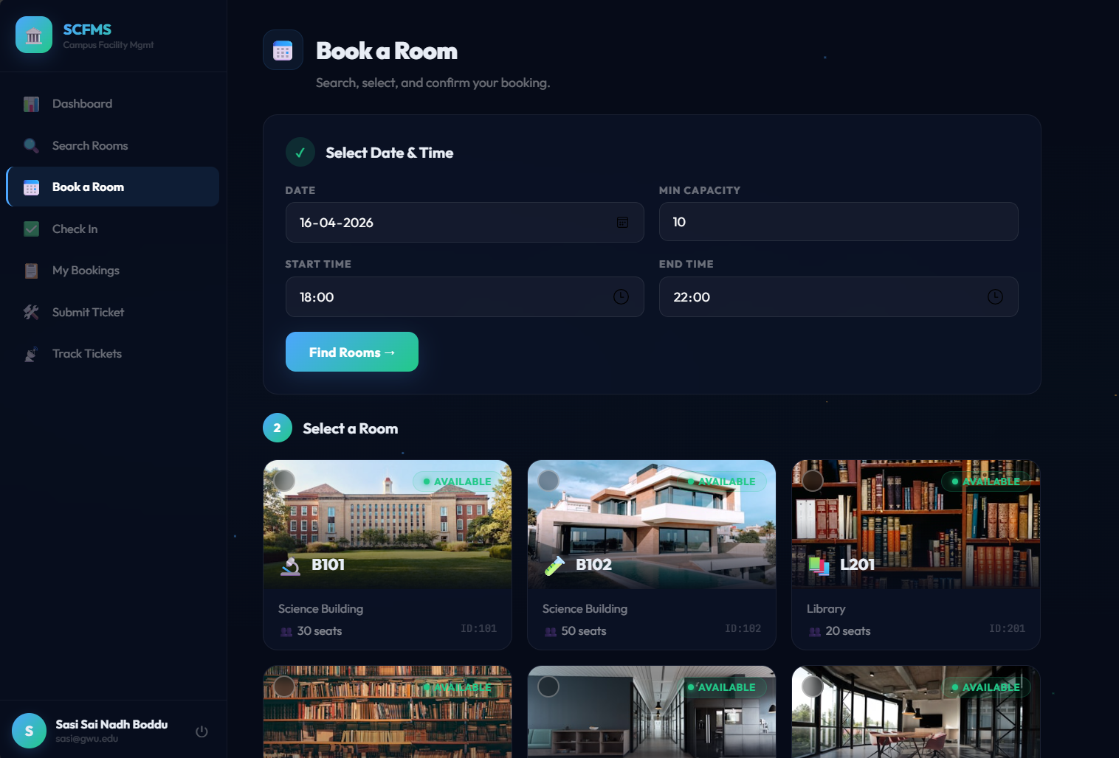
Book Available Room

Slide 25
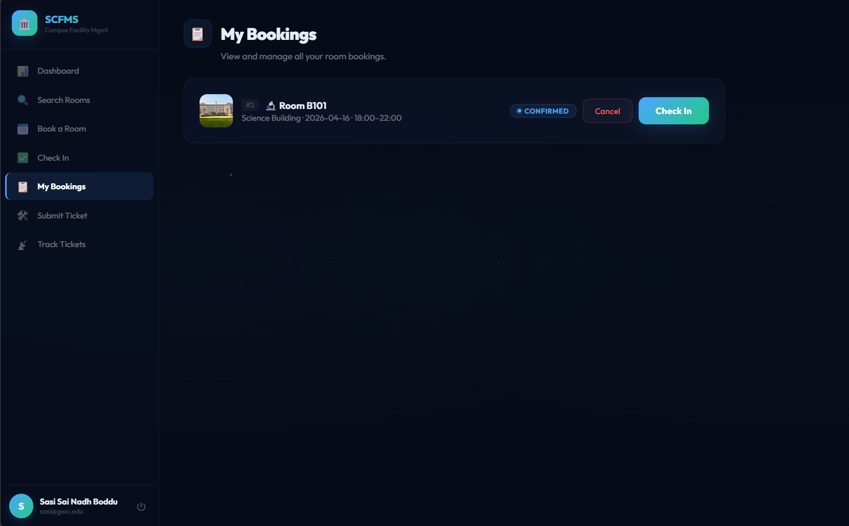
Active Booking

Slide 26
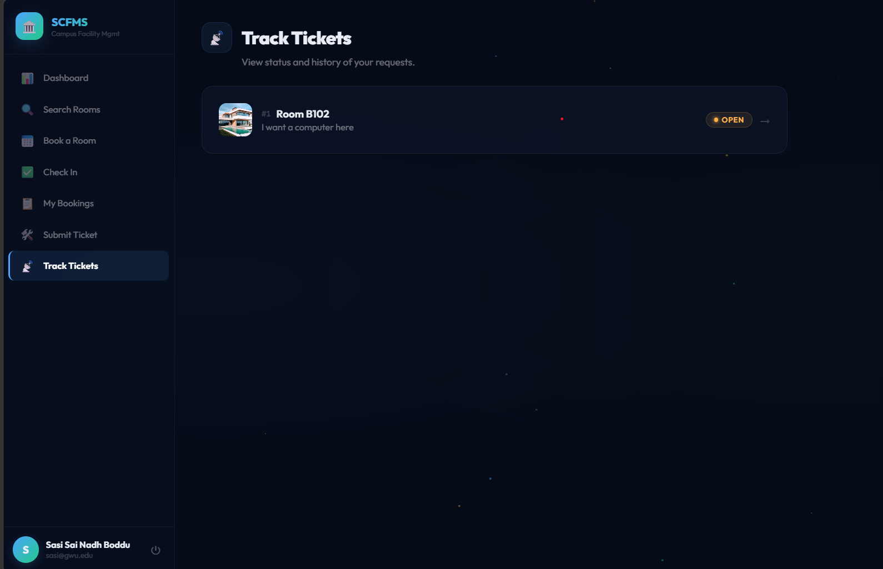
Track Tickets Raised

Slide 27
Thank You
SCFMS — Smart Campus Facility Management System
6
5
15+
1
Use Cases
Implemented
UML Model
Types
OO Classes
(BCE Pattern)
Working
Prototype
Sasi Sai Nadh Boddu | GWID: G22742105 | Group 24
Questions?

